Slide 1
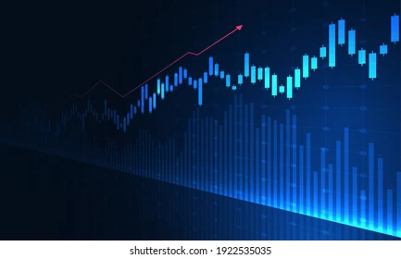
ALLOCENTRIC
An AI Assistant for Asset Allocation
Presented by : Team CodeBlooded

Slide 2

Problem Statement
Enhancing Portfolio management through AI-Powered Asset Allocation
AI-powered asset allocation is revolutionizing portfolio management by leveraging advanced algorithms, real-time data analysis, and predictive analytics to optimize investment decisions. This approach ensures portfolios are not only aligned with investors' financial goals but also adapt dynamically to changing market conditions, enhancing returns while managing risks.
Presented By : CodeBlooded

Slide 3
Goals
Asset allocation across various finance portfolios challenges entrepreneurs and civilians alike. It is something everyone wants to get right to save the money and invest it in a riskfree yet profit-generating portfolio. Our main objectives are:
Portfolio Management
Risk Assessment and Optimisation
Personalisation
Scenario Analysis and Forecasting
Presented By :CodeBlooded

Slide 4
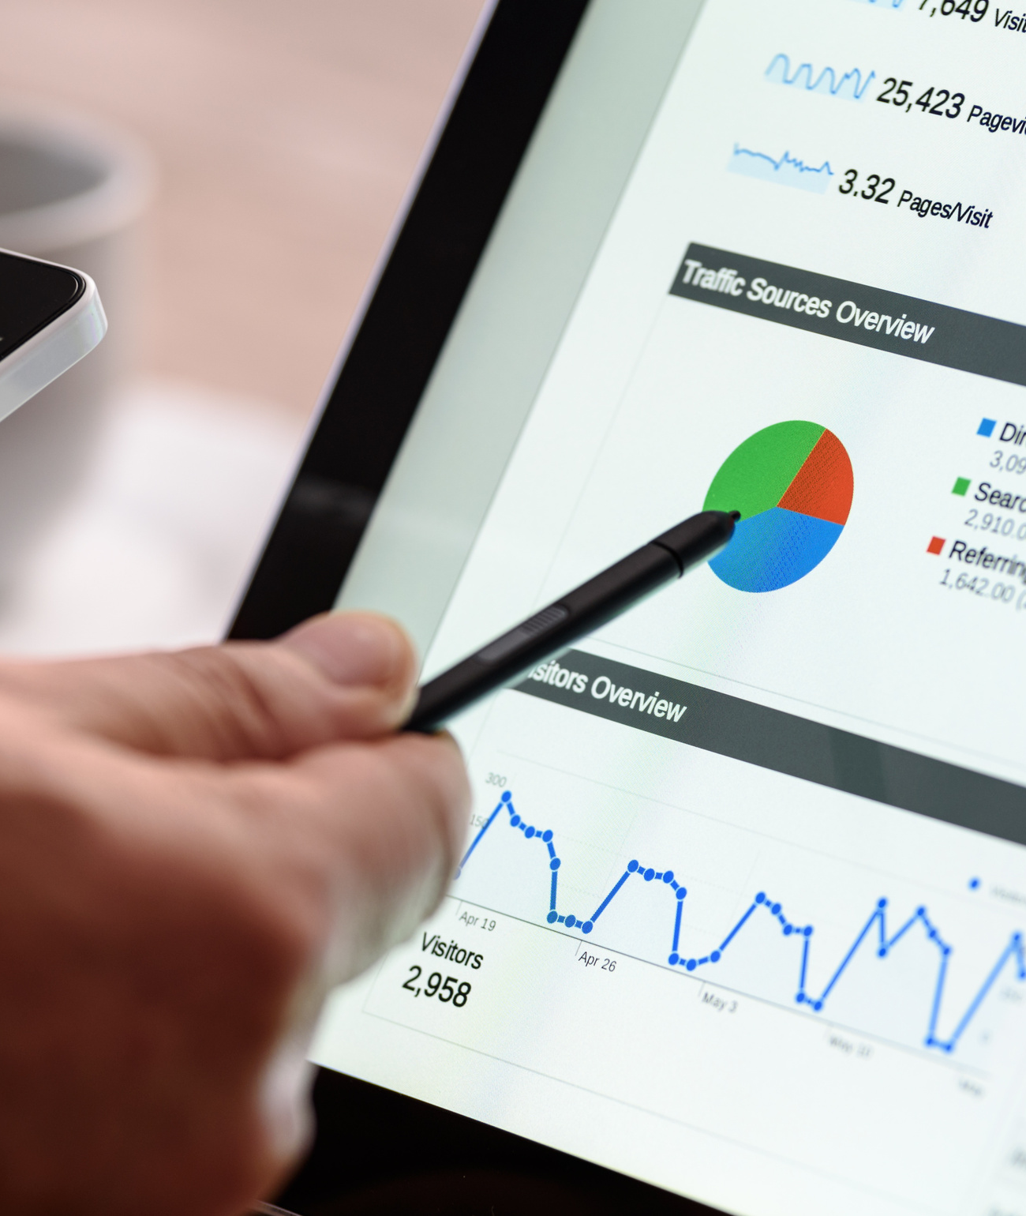
Solution or Strategy
We propose to tackle this challenge everyone faces based on mathematical predictions and risk calculations.
Suggests portfolio distribution across asset classes like equity, bonds, mutual funds, or alternative investments.
Visualizes potential gains or losses for informed decision-making.

Slide 5
Methodology
Data Collection
Data Preprocessing
APIs and Data Sources
Yahoo Finance API / yFinance: For historical and live stock prices, indices, and mutual fund data.
Scaling:
Use MinMaxScaler to normalise input data for models like LSTMs.
User Interface Development
Risk management
Web app - streamlit
Scaling:
Use MinMaxScaler to normalise input data for models like LSTMs.

Slide 6
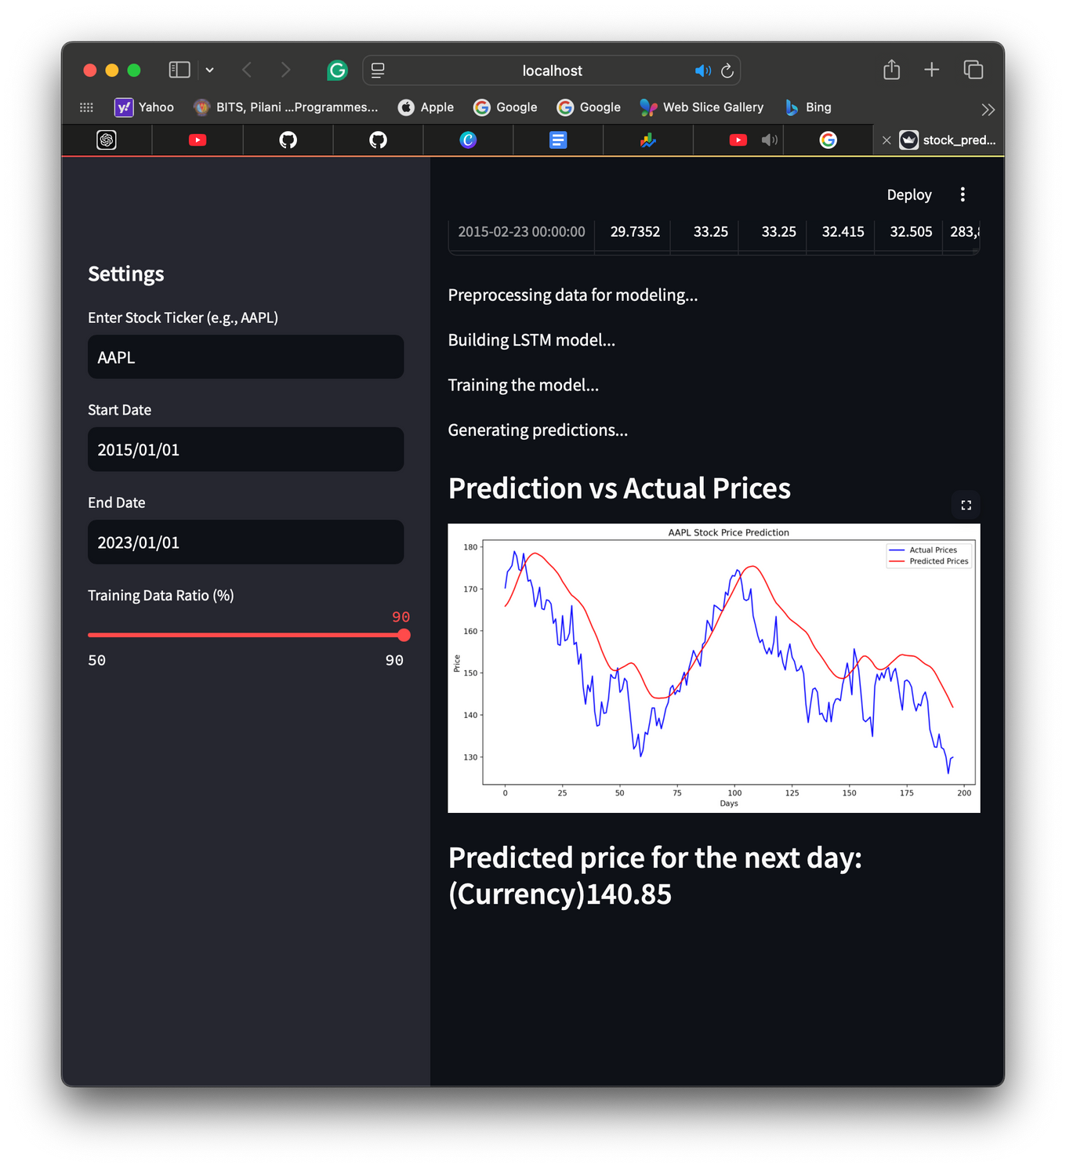
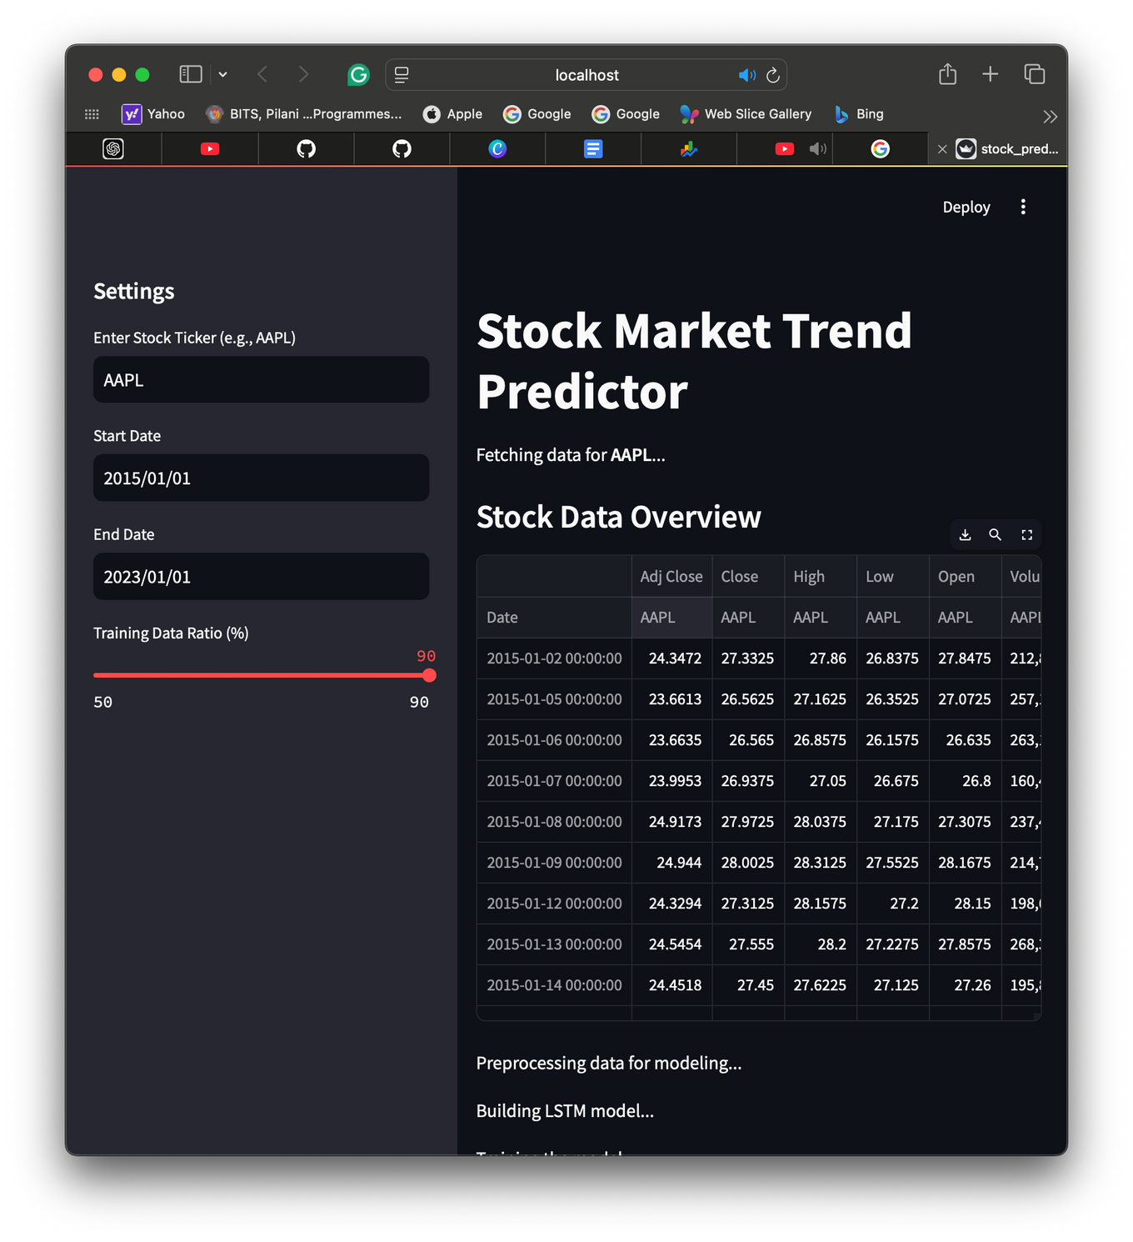
Comprehensive insights
Progress so far....

Slide 7

EXPECTED OUTCOMES
A comprehensive insight about different finance portfolios and risk predictions
A chatbot to interact with the user and to advice the user on various areas for investement

Slide 8
IMPLEMENTATION

Slide 9
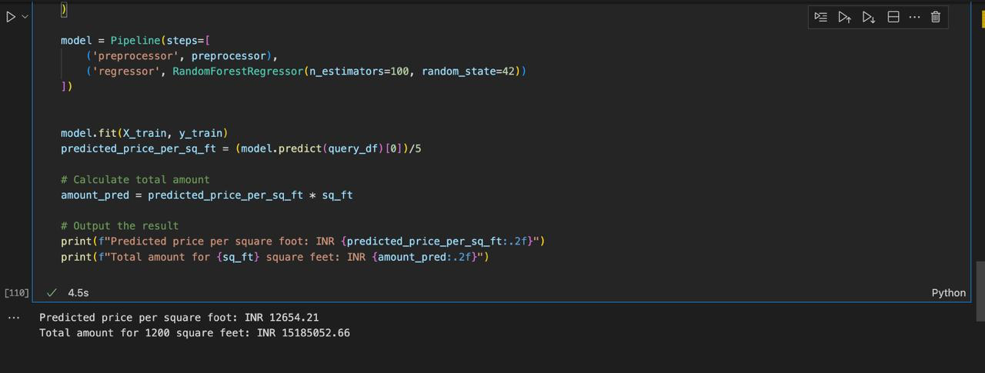
Real Estate Model that predicts the price per sq ft based on recent trends

Slide 10
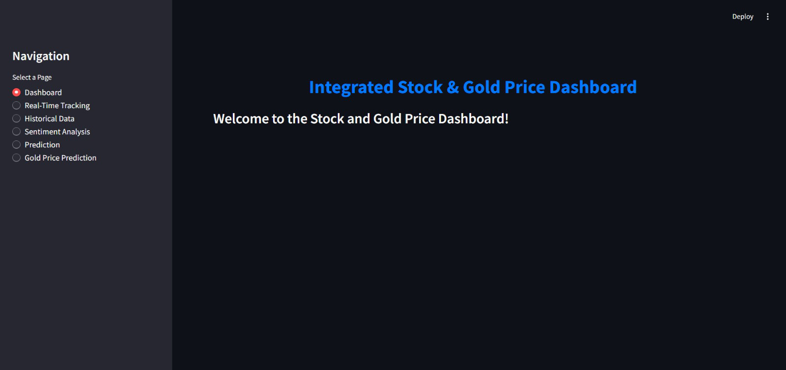
User Interface and Chatbot for Real Time Stock Analysis

Slide 11
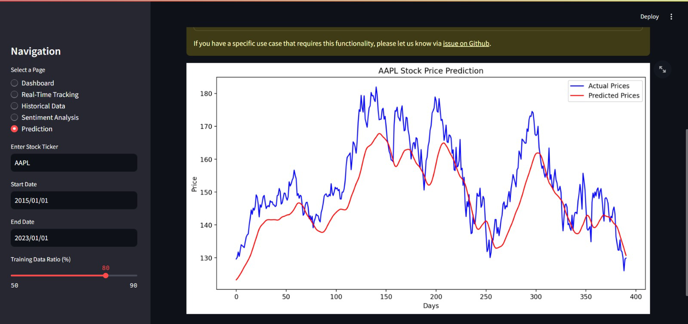
Stock Price Prediction using Historical Data

Slide 12
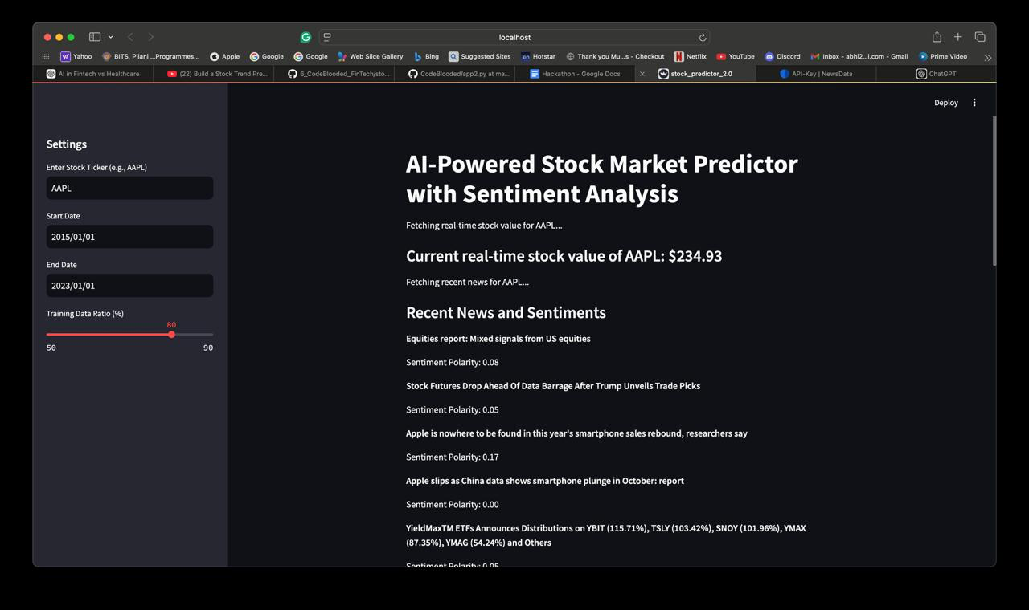
An AI Powered Stock Market Predictor

Slide 13
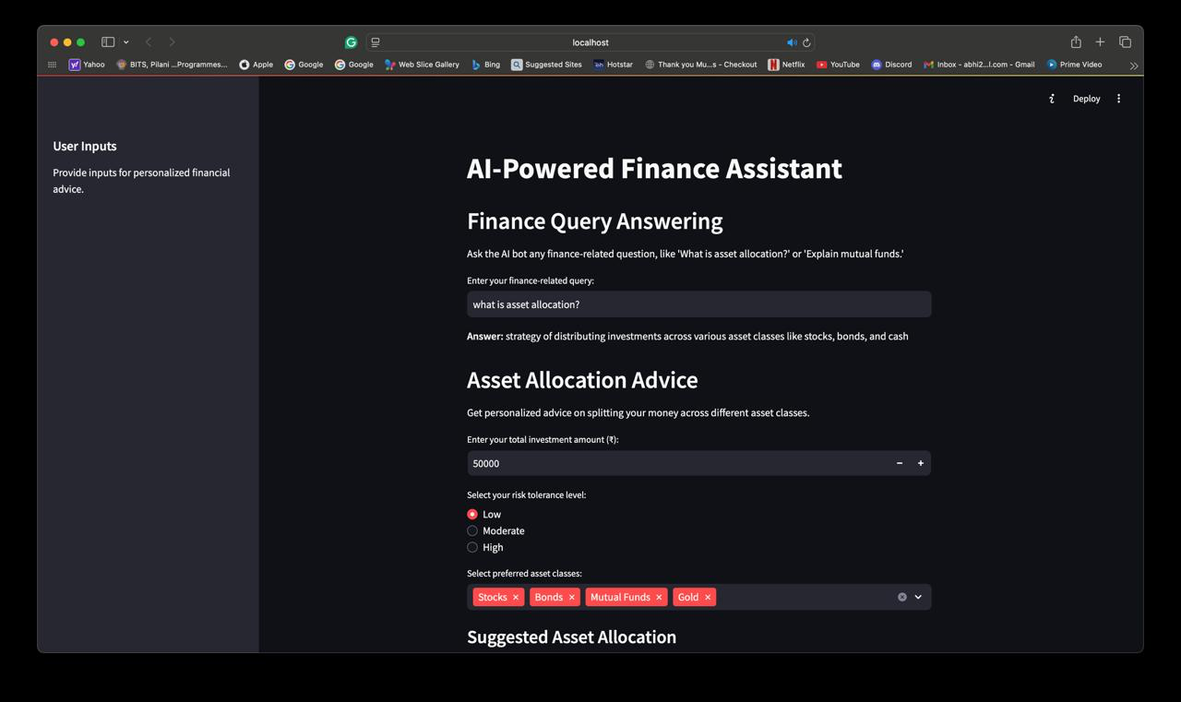
A chatbot that uses AI to provide financial advice

Slide 14
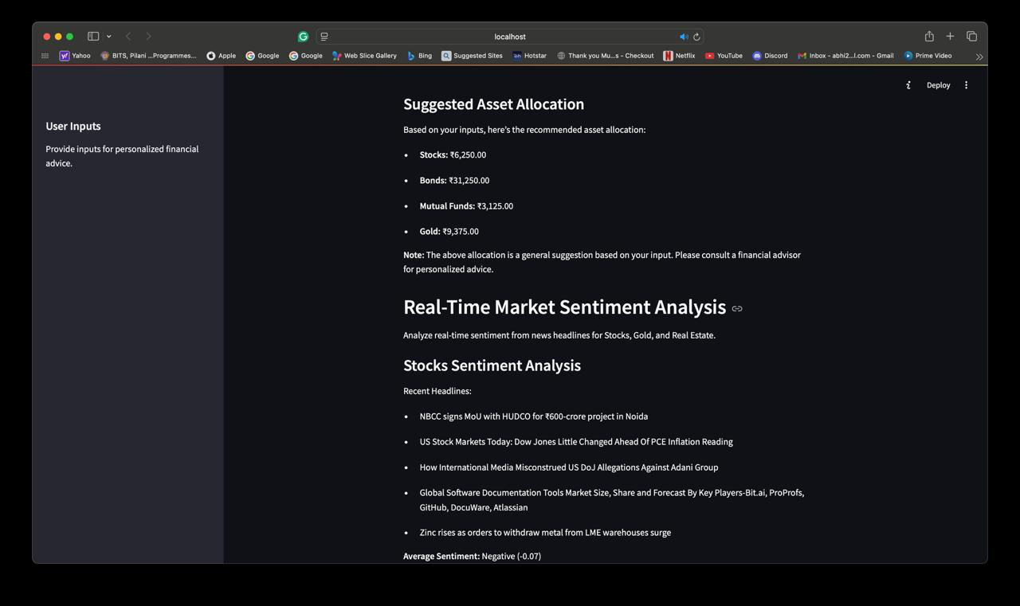
The chatbot strategically advices you to create different assets across various finance portfolios based on your risk assessment level along with real time news updates that might affect any stock market

Slide 15
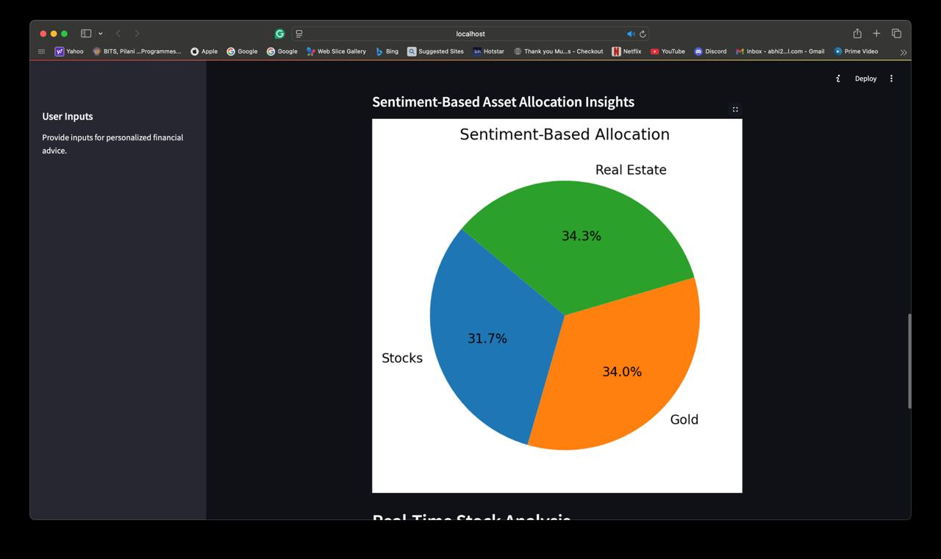
It presents the asset allocation information to the user in a comprehensive pie chart

Slide 16
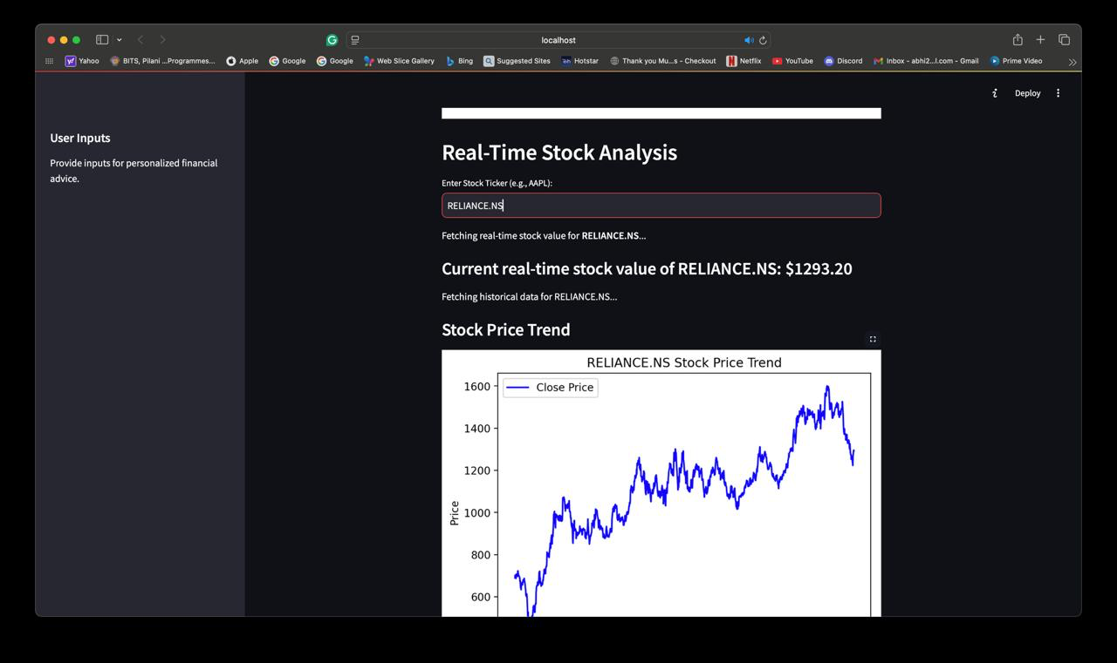
It helps the user analyse the stock trends in real time with graphs for visualisation

Slide 17


